Slide 1
Steganography
CAPSTONE PROJECT
Presented By: Akash Das
Student Name : Akash Das
College Name & Department : St. Thomas College of Engineering and Technology (CSE)

Slide 2
OUTLINE
Problem Statement
Technology used
Wow factor
End users
Result
Conclusion
Git-hub Link
Future scope

Slide 3
Problem Statement
Develop a secure system for embedding sensitive data within images using steganography techniques. The hidden data will be protected by a password to ensure only authorized access. The system will enable both the embedding of data into an image and the retrieval of data using the correct password.

Slide 4
Technology used
Programming Language: Python
Tools for Development:
Streamlit: Web framework for interactive apps (for GUI).
Tkinter: GUI toolkit for desktop applications.
OpenCV: Image processing for encoding/decoding messages.
NumPy: Efficient handling of image data in arrays.
Pillow: Image manipulation for display and resizing.
Deployment:
Git: For version control.
GitHub: For centralized repository for deployment and development.
Streamlit: For deployment.

Slide 5
Wow factors
Real-Time Image Processing: Instant feedback when encoding/decoding, improving user experience.
Dual-Interface Approach: Web (Streamlit) and Desktop (Tkinter) interfaces for flexible access.
Cross-Platform Accessibility: Works as both a web and desktop app for versatile device compatibility.
Easy-to-Use: Simple, user-friendly interface requiring no technical expertise.
Visual Message Embedding: Messages are embedded as imperceptible patterns within images.
XOR Encryption for Security: Ensures secure, private, and tamper-proof communication.
Dynamic Encryption Keys: Adjustable key lengths and encryption schemes for enhanced security.

Slide 6
End users
Privacy Seekers: Individuals desiring secure communication for personal messages.
Security Enthusiasts: Cryptography professionals and hobbyists.
Businesses: Companies needing secure internal communications.
Educational Institutions: Students and researchers studying cryptography.
Media Professionals: Journalists requiring confidential communication.
Government/Activists: High-security users needing tamper-proof communication.

Slide 7
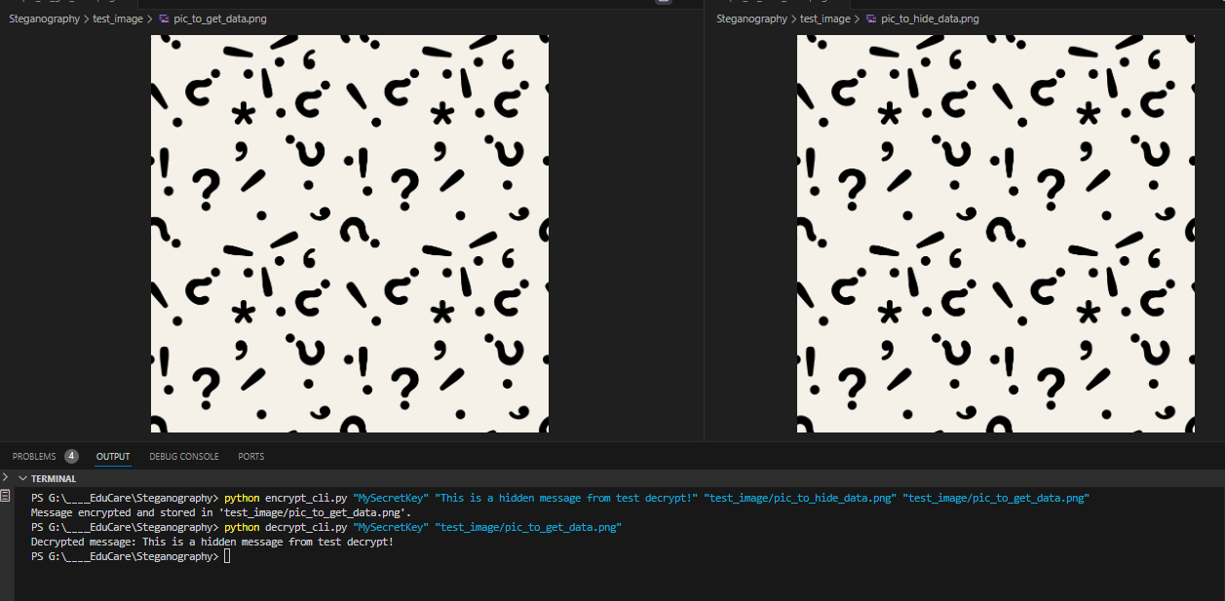
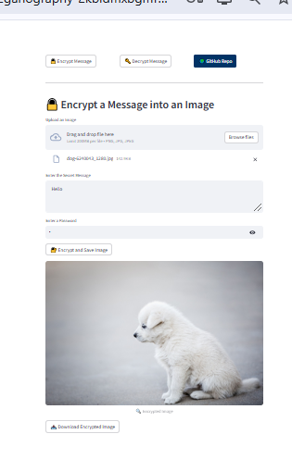
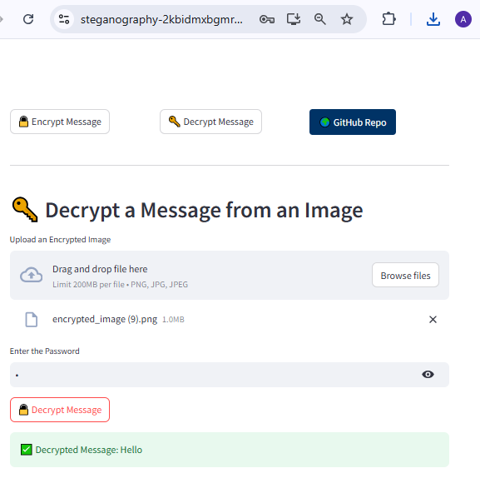
Results
CLI based Demo
GUI based Decryption
GUI based encryption

Slide 8
Conclusion
This project leverages XOR encryption and image processing to create a secure and intuitive way to encode and decode messages covertly.
It offers a unique combination of real-time feedback, dual-platform accessibility, and a user-friendly interface, making it suitable for a wide range of users seeking privacy in digital communication.
Its simplicity and security make it a valuable tool for anyone concerned about the confidentiality of their messages.

Slide 9
GitHub Link
GitHub Link: https://github.com/greedyknapsack/Educare_Internship
Deployed at (Try out at): https://steganography-2kbidmxbgmrqmmpnu3i9sb.streamlit.app/

Slide 10
Future scope
Advanced Encryption Algorithms: Integrating stronger encryption methods, such as AES or RSA, for higher security.
Message Authentication: Implementing digital signatures to ensure message integrity.
Mobile Application Development: Expanding to Android/iOS platforms for broader reach.
AI Integration: Using AI to detect steganographic patterns and improve message embedding accuracy.
Cloud Storage Support: Enabling encrypted storage of messages and images in the cloud for easy access and sharing.
Enhanced User Interface: Adding more customization options for the user interface, including themes and advanced settings.

Slide 11
THANK YOU

